Slide 1

Tableau DataViz Challenge - 2021
Topic: Horticulture
Tamil Nadu Crop Distribution
By Agrima Goel

Slide 2
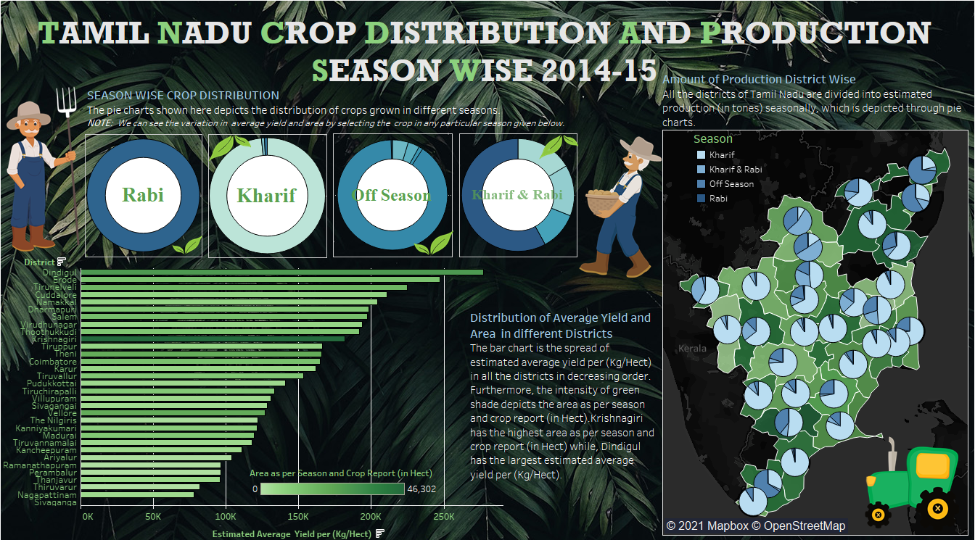

Slide 3
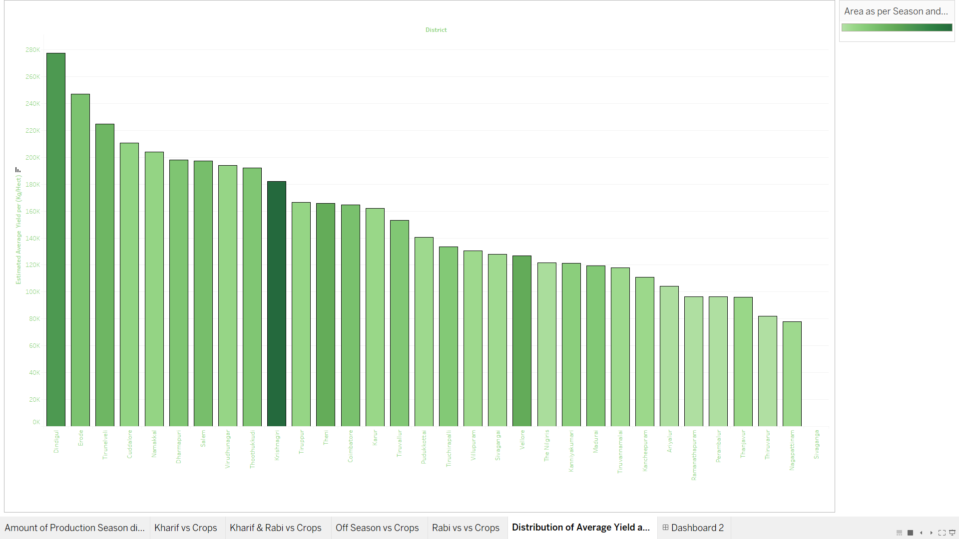
Distribution of Average Yield and Area in Different Districts

Slide 4
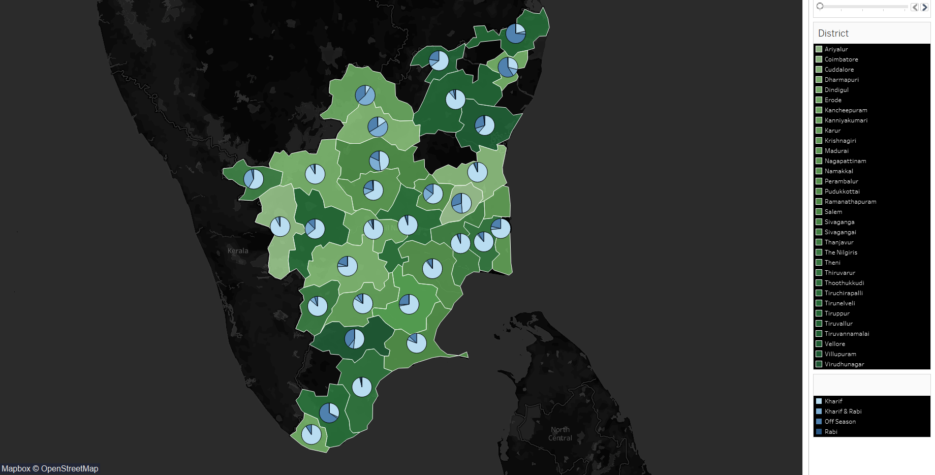
Amount of Production division seasonally District Wise

Slide 5
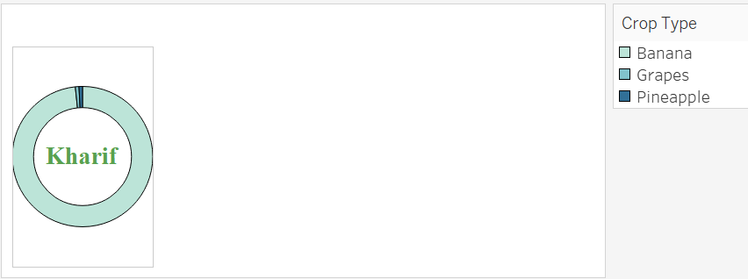
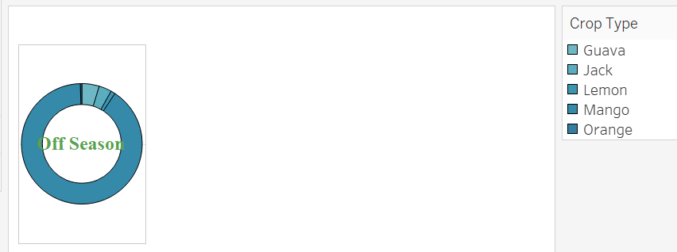
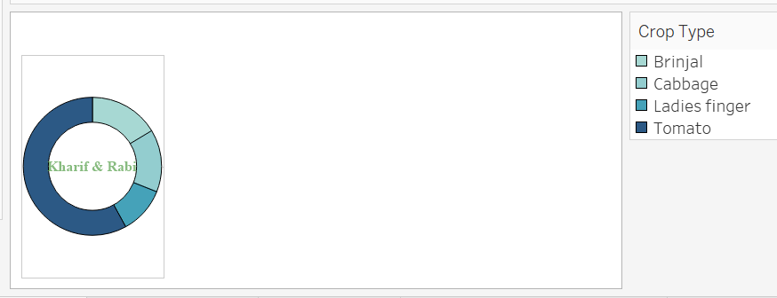
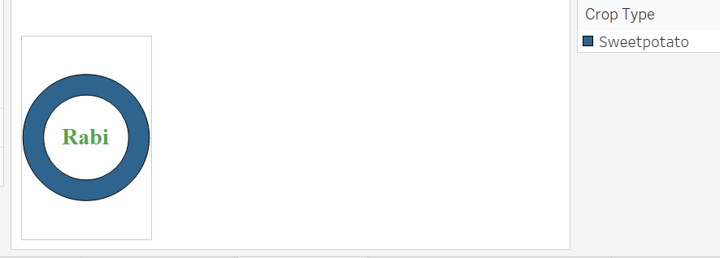
SEASON WISE CROP DISTRIBUTION

Slide 6
Project Video Link :-
https://drive.google.com/file/d/16lCf2ft9uUe9FN9DLYuamByfSfynZI09/view?usp=sharing
Tableau Dashboard Link :-
https://public.tableau.com/profile/agrima.goel#!/vizhome/TAMILNADUCROPDISTRIBUTIONSEASONWISE/Dashboard2

Slide 7
Thank You

